Slide 1

Maternal-to-Zygotic transition in Xenopus laevis is regulated by miRNA family 427
Yogindra Raghav,
Sarah Morgan, Peter Allen
Notes:
HIGHLIGHT THE FACT that we are the only group that did laevis.
Has L AND S chromosomes and is TETRAPLOID.

Slide 2
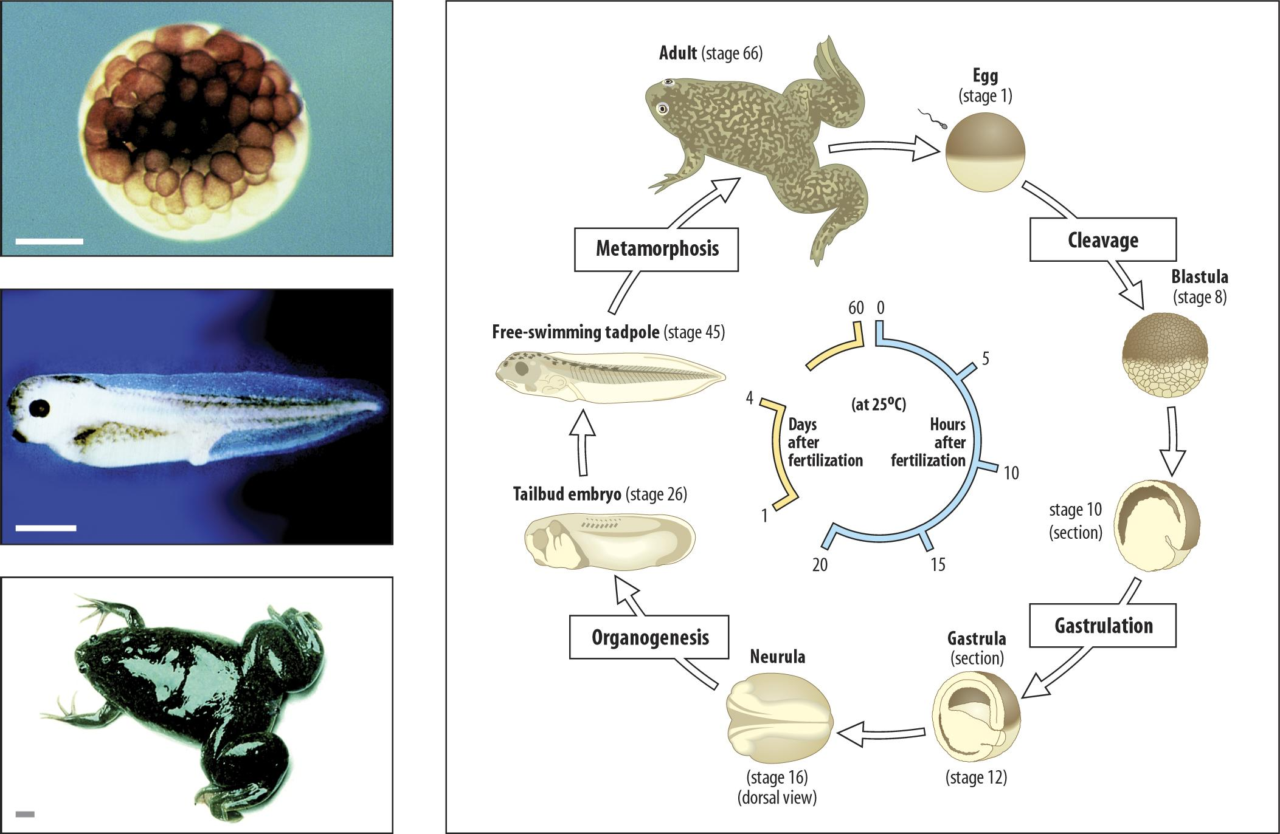
Early Stages of Life
Is there a correlation between the target sequence (GCACTT) of miR-427 being present in the 3’UTR of Xenopus laevis genes and maternal clearance?
Stages of
Xenopus laevis
that we investigated
Notes:
Talk about BACKGROUND RESEARCH AND QUESTION
Is tetraploid, so has L and S copies of each chromosome, each with different evolutionary backgrounds (this is from the instruction paper)

Slide 3
Methods
X laevis reference genome
SRR Numbers for Egg Stage and Stage 10
FASTQ files for Egg Stage and Stage 10
FASTQdump
Egg & St10 sam files
hisat2
GTF file for
X laevis
Aligned featureCounts files for Egg and st10
Egg & St10 bam files
Samtools
featureCounts
Differential Expression Analysis in R
Visualizations
Notes:
Run through these very BRIEFLY.
FASTQdump of SRR2517972 and SRR2517975
Aligned Reads with hisat2
Quantification using samtools and featureCounts
Differential Gene Expression Analysis in R
Quantification of maternally cleared L and S genes in Unix
We took the SRR numbers and ran FASTQ dump on them to get FASTQ files, we aligned these to the Xenopis laevis reference genome to get SAM files, then we used samtools to convert this to bam files. After this we used featureCounts to help quantify the number of reads. We put this data into R and did differential expression analysis on it to visualize it.

Slide 4
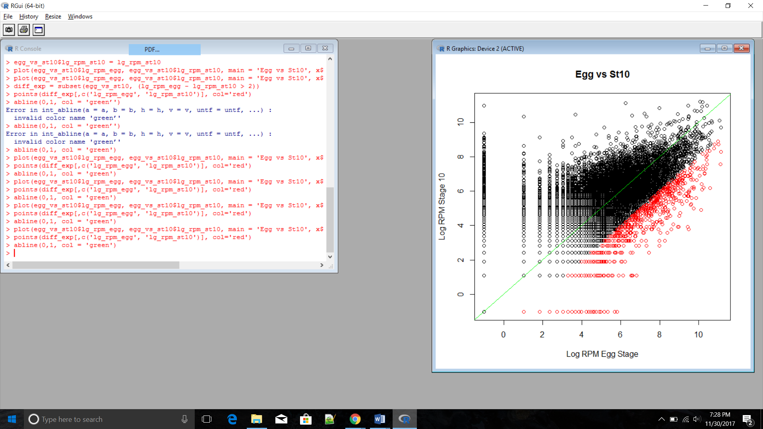
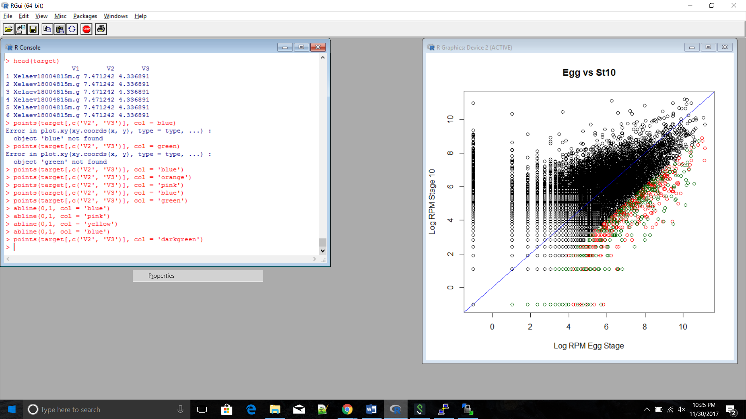
Log-fold significant vs “maternally cleared”
target sequence
no target sequence
Notes:
Differential gene analysis: Visualization of which ones were likely to be maternally cleared over time due to reduction in differential expression. (Write stuff about the R procedure here.) MENTION USE OF RPM INSTEAD OF TPM
61.8% of diff exp genes also had target sequence

Slide 5
Significance Test for Target Sequence
P < 0.05 | Stage 10 with sequence | Stage 10 without sequence | Total
Decreased | 550 | 1033 | 1853
No sig. decrease | 8204 | 19721 | 27925
Total | 8754 | 20754 | 29508
Notes:
Fisher’s test comparing Stage 10 reads with target sequence and without vs. Stage 10 reads that were determined as possibly maternally cleared/significantly decreased reads in R and those not. Significant at p<.05, so there is a significant correlation between having the sequence and significant decreases in differential expression. Grand total does match count of full .gtf file used.
AS you can see, most of the genes in the file did not have the target sequence, and of those that did, most did not show a statistically significant decrease from the egg stage to stage 10. But, as our Fisher’s tests show, there was a statistically significant correlation between having the target sequence, and showing signs of clearance.

Slide 6
Results, Limitations, Future Directions
Fisher test confirms significant connection between genes with the target sequence and decreased expression at stage 10 vs. egg stage
Future Directions: Understanding reasons for differences in maternal clearance between L and S chromosomes
Limitations: Only used one study’s data on expression changes, and only at two stages (egg and stage 10)
Notes:
Chr1,3,7 were shown to have significant differences in maternal regulation between L and S. why? Does it change at different stages?
We found that there was a statistically significant connection between a gene containing the miRNA target sequence (GCACTT) and a gene showing significant decreases in expression at stage 10 of development as opposed to the egg stage, which points to the possibility the of maternal clearance.
We saw that a sizable portion of genes with the target sequence in their 3’ UTR did not show signs of maternal clearance, but of all genes that did noticably decrease from the Egg to St 10, there was a significant
All we’ve done so far with the L and S genes in laevis is determining that, based on the datasets we used, that some chromosomes do have significant differences in clearance, in the future we could investigate this further, maybe trying to understand why, looking for other potential target sequences?

